Slide 1
The NIH Public Access Policy
NIH Regionals
May 2016
Katie Funk, Neil Thakur, Bart Trawick
Posted at http://publicaccess.nih.gov/communications.htm

Slide 2
Today’s Discussion: The NIH Public Access Policy
The Basics
Awardee Tasks
NIHMS: Processing Manuscripts
Reporting Papers
My NCBI Features: A Primer
Enhancing Compliance
Compliance Monitoring for Institutions
Ways Institutions Can Ensure Compliance

Slide 3
The NIH Public Access Policy
        The Basics:
        The Policy
        Its Implications

Slide 4
The NIH Public Access Policy Is Mandatory
The Policy implements Division G, Title II, Section 218 of PL 110-161 (Consolidated Appropriations Act, 2008) which states:
The Director of the National Institutes of Health shall require that all investigators funded by the NIH submit or have submitted for them to the National Library of Medicine’s PubMed Central an electronic version of their final, peer-reviewed manuscripts upon acceptance for publication, to be made publicly available no later than 12 months after the official date of publication: Provided, That the NIH shall implement the public access policy in a manner consistent with copyright law.
Where to Make Public
What to Submit
When to Submit
When to Make Public
4
4
Notes:
4
NIH must implement this policy because it is the law.
Making published research funded by NIH publicly available is an important opportunity to advance science and improve human health.
What to submit? Final, peer-reviewed manuscripts
When to submit? Upon acceptance for publication
When to make public? No later than 12 months after the official date of publication
Where to make public? The National Library of Medicine’s Pubmed Central
Speakers notes Revised 9/29/08
3/9/09- updated with new guide notice

Slide 5
The Policy Applies to Any Manuscript That…
Is peer-reviewed;
Is accepted for publication in a journal on or after April 7, 2008;
And, arises from:
  Any direct funding from an NIH grant or cooperative agreement active in Fiscal Year 2008 or beyond, or;
  Any direct funding from an NIH contract signed on or after April 7, 2008, or;
  Any direct funding from the NIH Intramural Program, or;
  An NIH employee.
5
5
Notes:
5
The Policy applies to all final peer-reviewed manuscripts. The Policy does not apply to non-peer-reviewed materials such as correspondence, book chapters, and editorials.
The NIH Public Access Policy applies to all final peer-reviewed manuscripts that arise from the NIH intramural program or any amount of direct costs1 funded by NIH, regardless of the source or amount of other funding.
1 Costs that can be specifically identified with a particular project or activity. NIH Grants Policy Statement, Rev. 12/2003; http://grants.nih.gov/grants/policy/nihgps_2003/NIHGPS_Part2.htm#_Toc54600040.
Updated 4/22/08
Updated 3/23/09 to comply with Division F Section 217 of PL 111-8 (Omnibus Appropriations Act, 2009)
Updated 11/16/09
** Until further notice, papers written in scripts other than Latin (e.g., Russian, Japanese) cannot be processed by the NIHMS. These papers are not required to be posted on PubMed Central and do not require evidence of compliance on applications, proposals or reports. The NIHMS continues to process papers written in Latin (Roman) script that contain characters and fonts used in standard mathematical notation. See http://grants.nih.gov/grants/guide/notice-files/NOT-OD-10-009.html for details.
Updated 11/19/09 to include Guide Notice Link

Slide 6
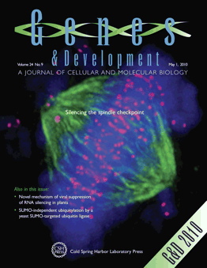

Definitions: Article Types
Final Published Article
Journal’s authoritative copy of the paper
Includes peer review modifications plus
copyediting and formatting changes
Submitted by Publishers/Journals to PMC
(Methods A&B)
Final Peer-Reviewed Manuscript:
Author’s final manuscript of a peer-reviewed
paper accepted for journal publication
Includes all modifications from the peer review
process
Submitted by Authors and Publishers/Journals
to PMC (Methods C&D)
Notes:
Through out the presentation and website, we use the word ‘paper’ as a generic word for all versions of a scientific peer-reviewed article, including final peer review manuscripts and final published articles
Genes and Development is a “Method A Journal” (5/17/20100

Slide 7

PubMed vs PubMed Central (PMC)
  Free resources developed by the U. S. National Library of Medicine
Biomedical journal citations + abstracts
Some links to full text articles at PMC and publisher websites.
Unique identifier: PMID followed by a series of numbers.
vs
Digital archive of full-text, peer-reviewed journal papers.
Unique identifier: PMCID followed by a series of numbers.
Notes:
PubMed and PubMed Central (PMC) are free resources that are developed and maintained by the National Center for Biotechnology Information (NCBI), at the National Library of Medicine (NLM), at the National Institutes of Health (NIH).
PubMed comprises more than 19 million citations for biomedical literature from MEDLINE, life science journals, and online books. Citations may include links to full-text content from PubMed Central and publisher web sites.

Slide 8
Awardee Tasks
        Address Copyright
        Posting Papers
        Documenting Compliance

Slide 9
Address Copyright
  Institutions and investigators are responsible for ensuring full compliance with the Public Access Policy.
Make sure the copyright transfer agreement allows the final peer-reviewed manuscript to be submitted to NIH.
We encourage authors to consider
Who will submit the paper and/or approve the submission?
What version of the paper will be made available on PMC?
When will it be submitted and when will the paper be made public on PMC?
9
9
Notes:
Authors own the original copyrights to materials they write. Consistent with individual arrangements with authors' employing institutions, authors often transfer some or all of these rights to the publisher when the journal agrees to publish their paper. Some publishers may ask authors to transfer copyrights for a manuscript when it is first submitted to a journal for review.
Authors should work with the publisher before any rights are transferred to ensure that all conditions of the NIH Public Access Policy can be met. Authors should avoid signing any agreements with publishers that do not allow the author to comply with the NIH Public Access Policy.
Federal employees always may submit their final peer-reviewed manuscript to PubMed Central, because government works are not subject to copyright protection in the United States.
Points to consider section added 3/11/09

Slide 10
Posting Papers: Methods A and B straight to PMC
Journal deposits the published version of all NIH-funded articles in PMC.
A
Final published article in PMC
Author arranges for Publisher to deposit published version of specific article in PMC.
B
Notes:
http://publicaccess.nih.gov/submit_process_journals.htm#journals

Slide 11
Posting Papers: Methods C&D via the NIHMS
Author Approval
Author or other submits final peer reviewed manuscript to the NIHMS.
C
Manuscript archived in PMC
NIHMS sends author an email asking author to approve the submitted materials for processing.
Author reviews and approves the PMC-formatted manuscript .
Journal publisher submits final peer reviewed manuscript to the NIHMS.
D
After submission is complete, NIHMS emails the citation with PMCID to author and PIs
  Remember:
  Only Authors can approve the submission and web versions of the manuscript.
  Awardees need an NIHMSID upon acceptance for publication.
Notes:
http://publicaccess.nih.gov/submit_process_journals.htm#journals

Slide 12
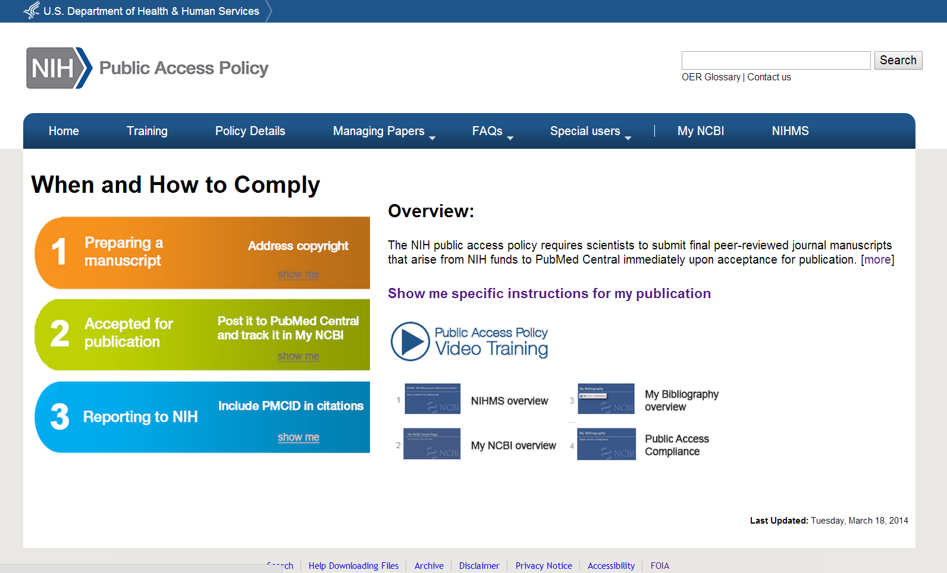
Identifying Submission Method by Journal Name
http://publicaccess.nih.gov

Slide 13
NIH Manuscript Submission System: Submitting and tracking papers

Slide 14
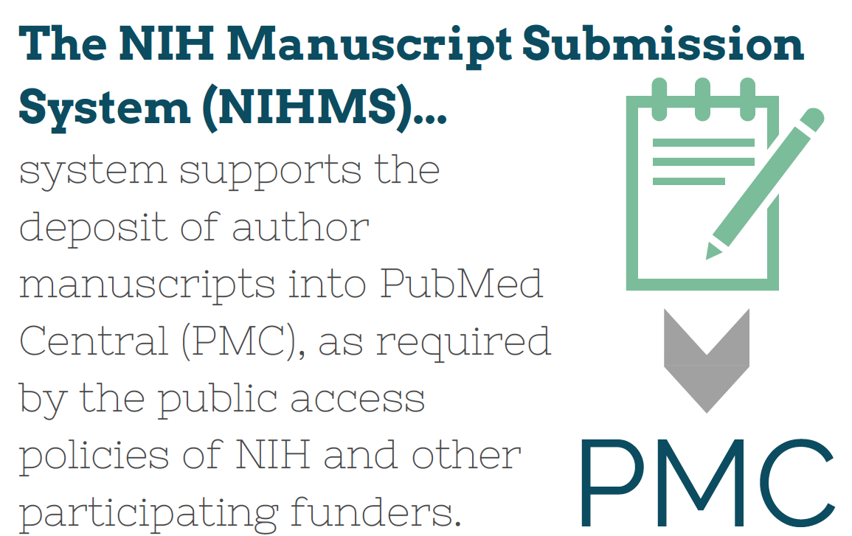

Slide 15
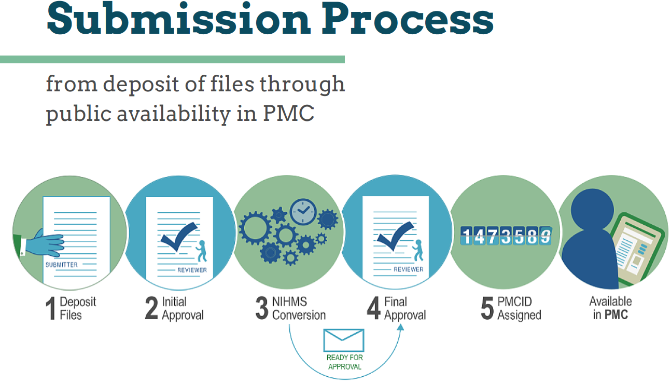
Notes and Tips for Researchers:
Use the same sign in route each time (see email).
Typically takes about 2-3 weeks from initial approval until first notification of final approval.
Deposit at time of acceptance. Don’t wait until publication or embargo period is up.
PMCID is assigned when final approval is complete and final publication information is available.

Slide 16
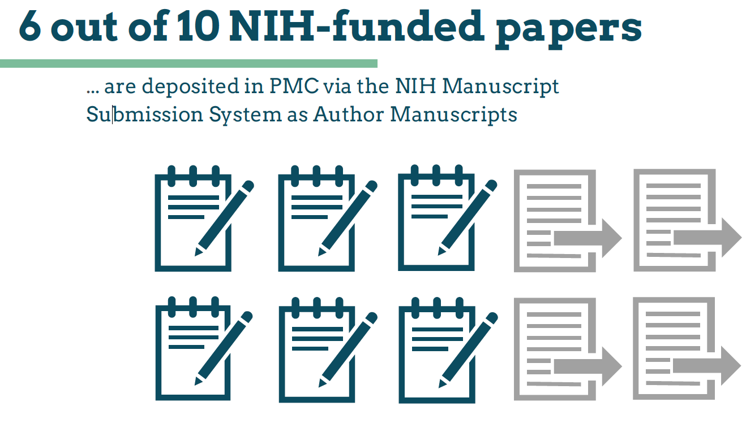


Slide 17


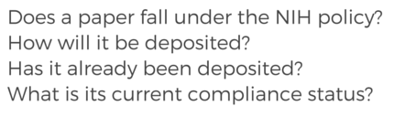

Slide 18
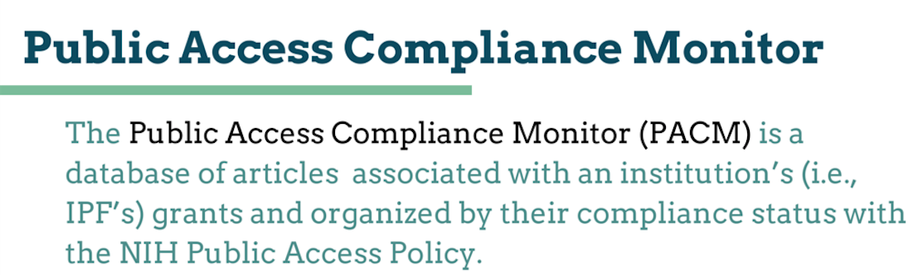

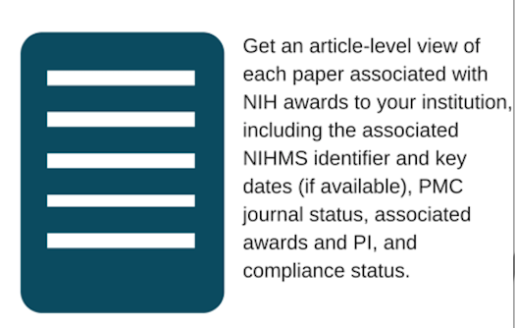


Slide 19



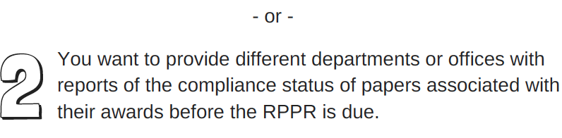
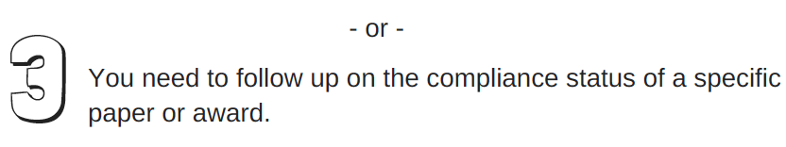


Slide 20




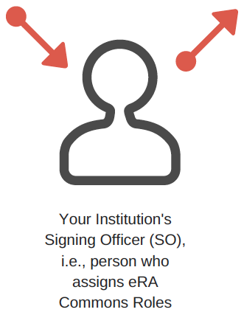
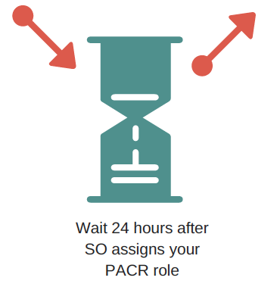

Slide 21
Reporting

Slide 22
Documenting Compliance
How to cite papers archived in PMC
  When citing a paper in NIH applications, proposals, and progress reports, include the PMCID at the end of the full citation.
  Applies to papers that fall under the Policy and are authored or co-authored by you.
  Example
    Varmus H, Klausner R, Zerhouni E, Acharya T, Daar A, Singer P. 2003. PUBLIC HEALTH: Grand Challenges in Global Health. Science 302(5644): 398–399. PMCID: PMC243493
Notes:
If a PMCID is not yet available, include the NIH Manuscript Submission system reference number (NIHMS ID) instead.
Please use the PMC prefix in front of a PubMed Central reference number

Slide 23
Documenting Compliance
How to cite papers in press (epub ahead of print),
or within 3 months of publication
For Method A and B Journals, use “PMC Journal - In Process”.
  Example: Sala-Torra O, et al. Connective tissue growth factor (CTGF) expression and outcome in adult patients with acute lymphoblastic leukemia. Blood. PMCID: PMC Journal - In Process
For Method C and D Journals, use the NIHMSID.
  Example: Cerrato A, et al. Genetic interactions between Drosophila melanogaster menin and Jun/Fos. Dev Biol. In press. NIHMSID: NIHMS44135
NIHMSIDs will not be accepted 3 months after publication.
    PMCIDs are assigned around the time of publication.
    Use the PMCID once it is assigned.
23
23
Notes:
23
See http://publicaccess.nih.gov/citation_methods.htm for more information
Updated for SF424 Compliance 11/26/08
Website updated 3/19/09
Updated 9/4/09 to reflect NOT-OD-09-136, Clarification on the Use of an NIHMSID to Indicate Compliance with the NIH Public Access Policy

Slide 24
My NCBI: a Primer

Slide 25
What is My NCBI?
My NCBI is a free account system that provides customized services for many NCBI databases, such as PubMed.
Key features for our discussion:
Can be linked to eRA Commons accounts
Commons-linked users can associate publications with NIH grants
Tracks NIH Public Access compliance
The only way to enter publications into the RPPR
Creates a PDF report format for other NIH reporting

Slide 26
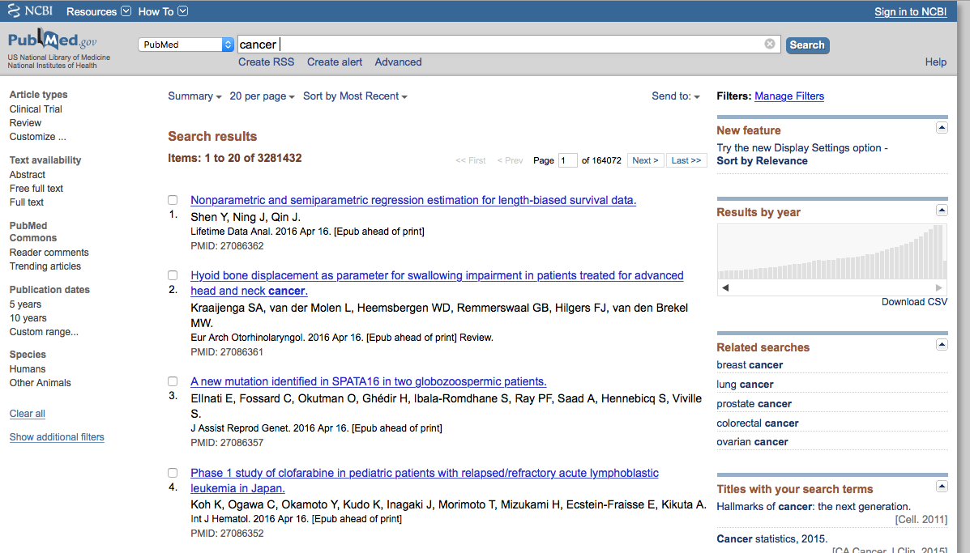
Signing in to NCBI

Slide 27
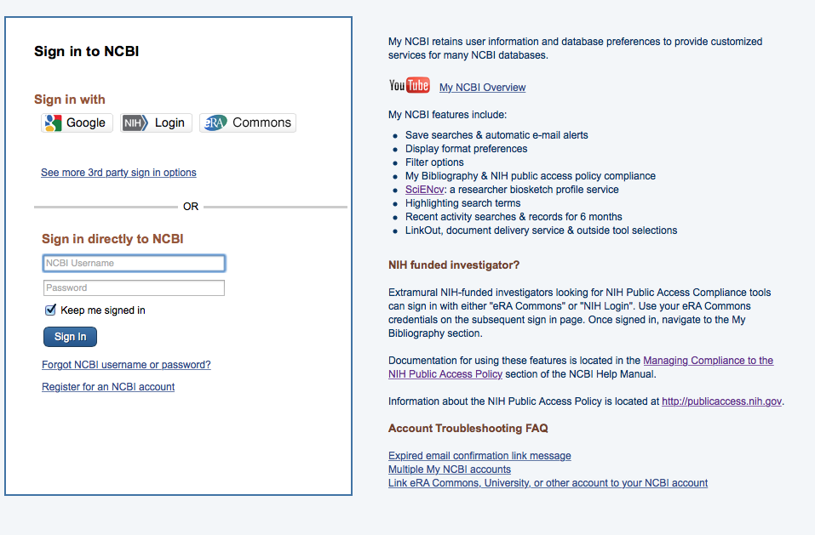
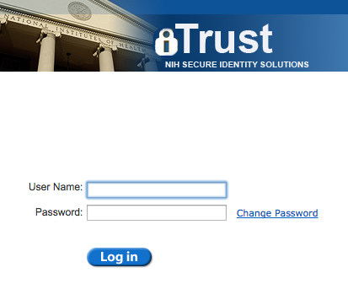
Signing in to NCBI

Slide 28
Which eRA users should have linked My Bibliography accounts?
Principal Investigators
Anyone else with NIH support who is or was an author
  Post-Doctoral Role
  Graduate Student Role
  Scientist Role
  Project Personnel Role
http://era.nih.gov/files/eRA_Commons_Roles.pdf

Slide 29
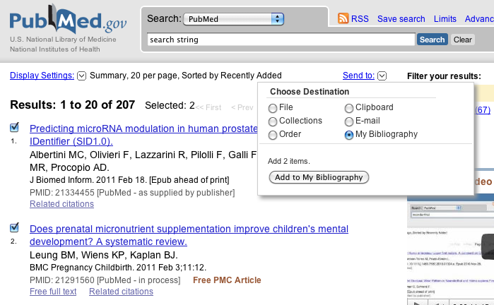
Adding PubMed Citations

Slide 30
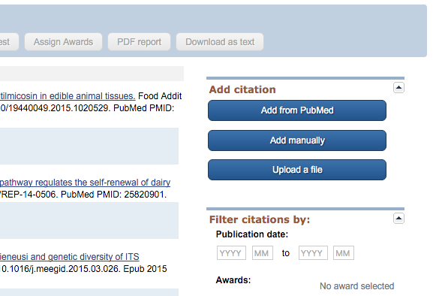
New options for adding citations to My Bibliography

Slide 31
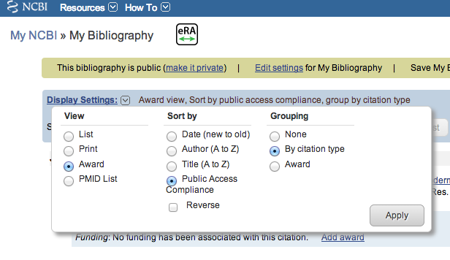
Award View option for eRA-linked users

Slide 32




Award View NIHPA compliance codes

Slide 33
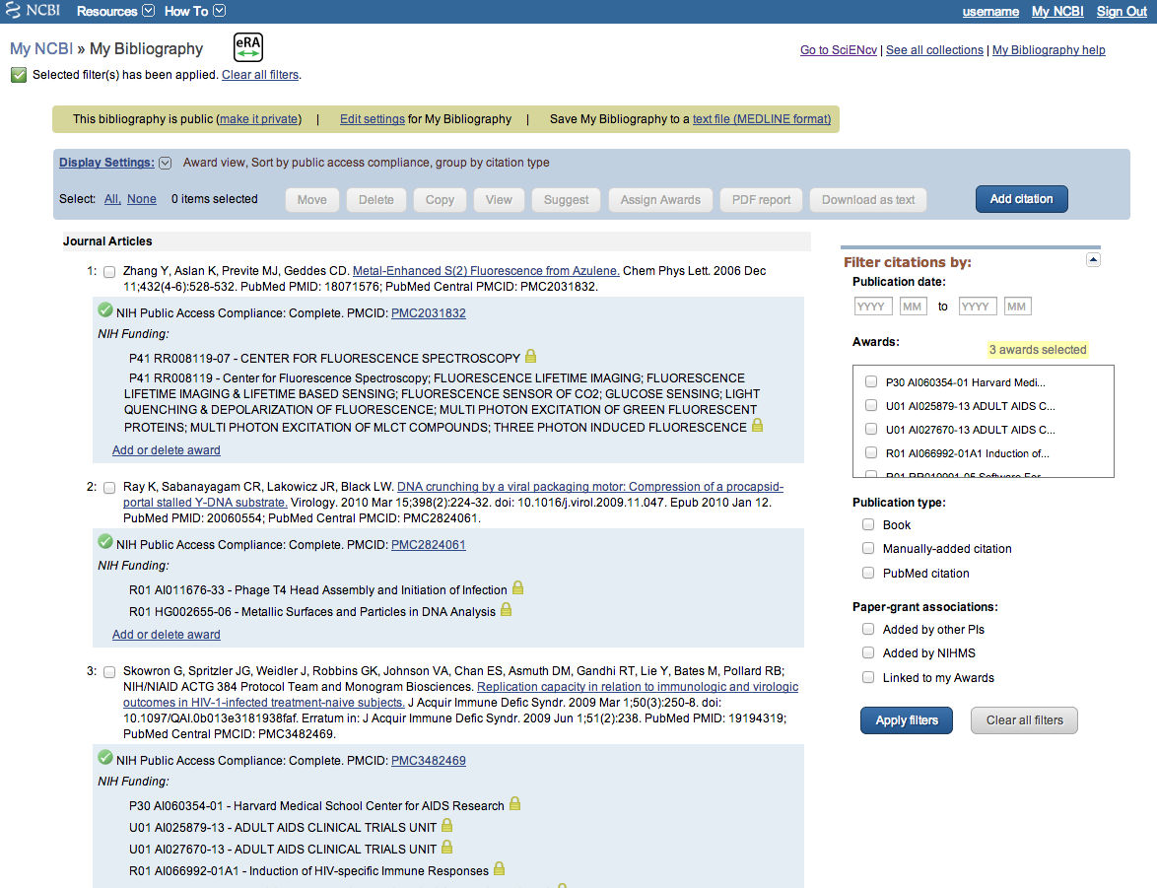
My Bibliography, Award View

Slide 34
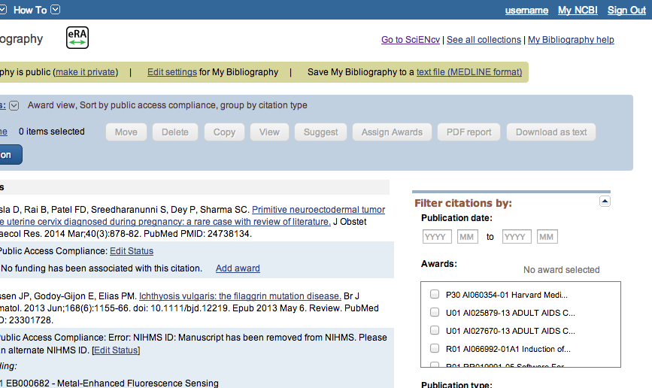
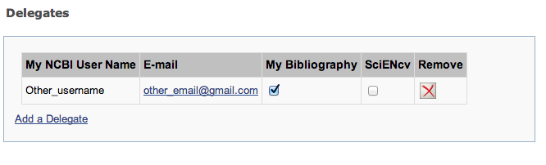
Delegation in My Bibliography

Slide 35
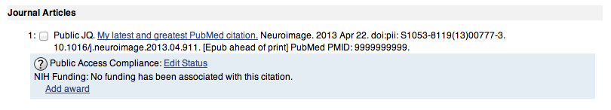
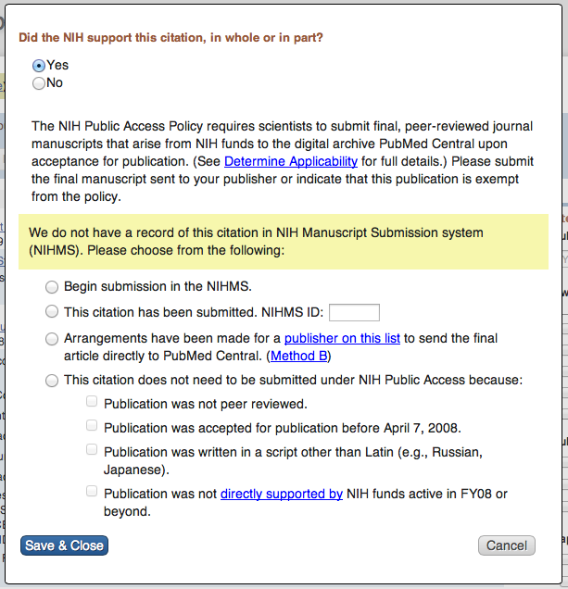
PI adds a new citation to their My Bibliography

Slide 36
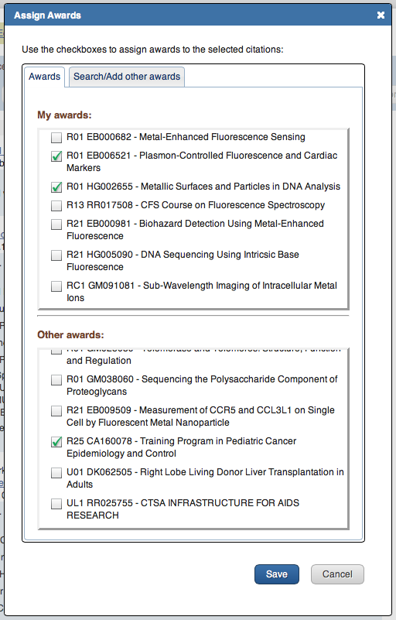
PI adds a new citation to their My Bibliography

Slide 37
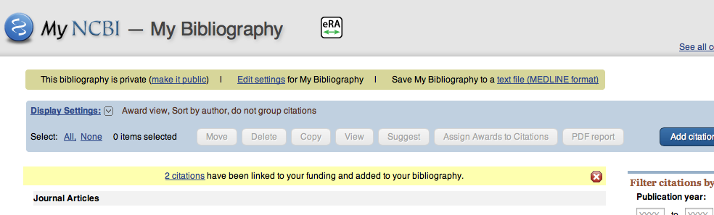
Another user links a PI’s grant to a citation

Slide 38
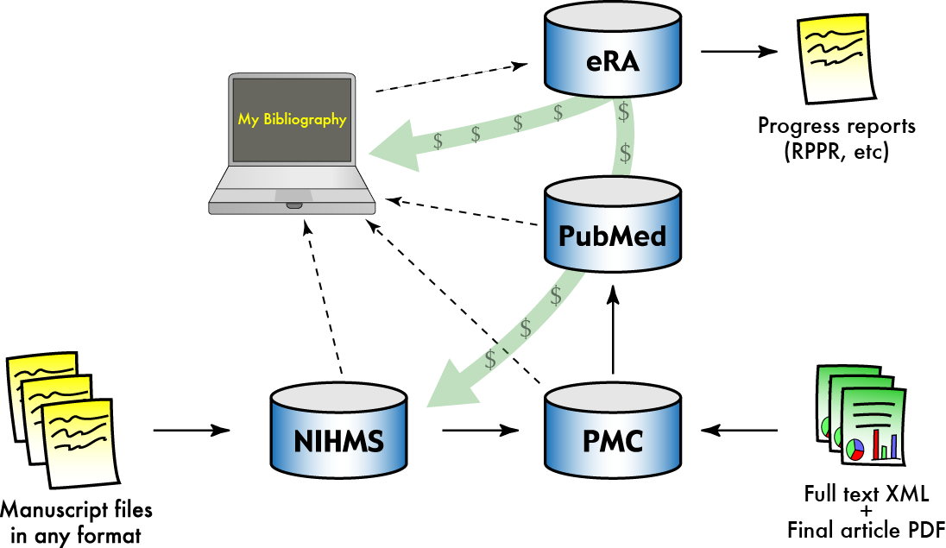
Compliance management with My NCBI

Slide 39
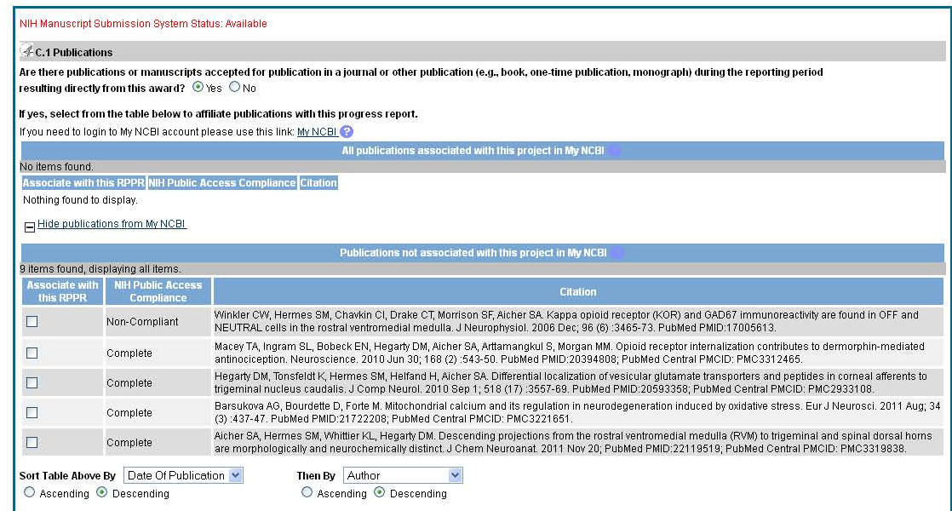
Display on RPPR
10
Notes:
Note, this slide is drawn from early test data, and labeled the first citation as non-compliant, when it should be N/A because it was published in 2006. However, to make it clear how an Non-Compliant paper will display, I changed the publication year on the slide to 2010.

Slide 40
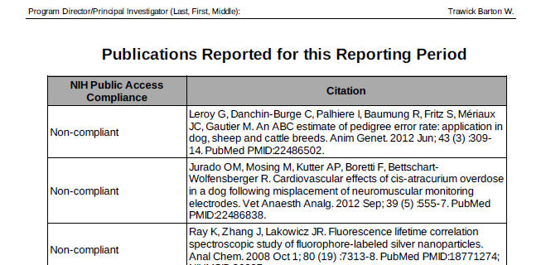
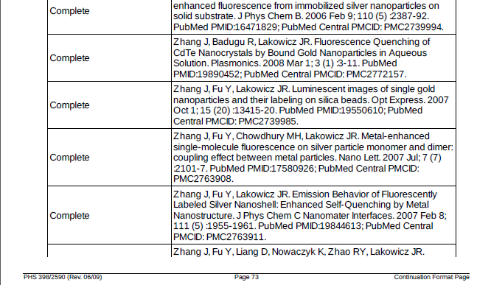
My NCBI PDF reports

Slide 41
Enhancing compliance
        Scope
        My NCBI, RPPR and PHS 2590

Slide 42
For non-competing continuation awards
(NOT-OD-12-160) For non-competing continuation with a start date of July 1, 2013 and beyond
Awards will be placed on hold until grantees have demonstrated compliance
My NCBI is required to report papers, when electronically submitting progress reports using the Research Performance Progress Report (RPPR)
PDF reports generated from My NCBI are required, when submitting paper progress reports using the form PHS 2590 (replaces publication section)

Slide 43
RPPR and E Notification
Trigger: When a grantee submits a RPPR to NIH that associates 1 or more publications with the award for which the public access compliance status is “Noncompliant”.
Recipients: to the PD/PI, with a cc to the AO, SO, GMS, IC mailbox, and PO.
Response: The grantee may respond to the eNotification via email or through the Progress Report Additional Materials (PRAM) link.

Slide 44
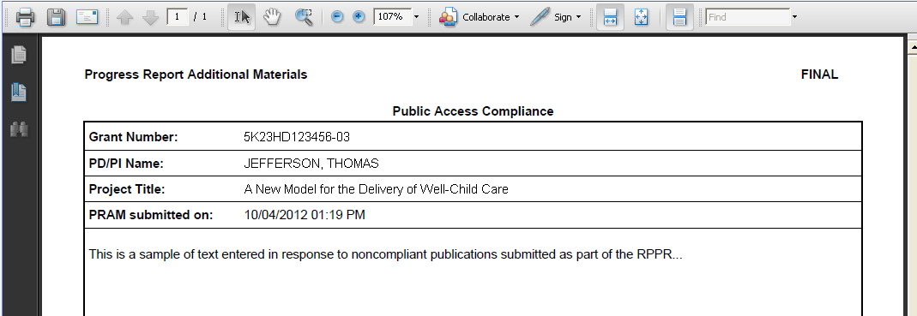
Example: PRAM for Public Access

Slide 45
Policy Update: Public Access and Resource Sharing
If an NIH award’s only contribution to a publication is a shared resource, do not list the publication in section C.1 of an RPPR or in the progress report publication list of a Renewal application.
Instead
  RPPR: opt to list and/or summarize these publications in section B.2. List/ summary does count against two-page limit.
  Renewals: opt to list and/or summarize these publications in the appropriate sharing plan (Data Sharing Plan, Genomic Data Sharing Plan, Model Organism Sharing Plan Resource Sharing Plan, etc.).
List/summary is always optional, and does not have to be complete
Implications: less burden, more accurate reporting
https://grants.nih.gov/grants/guide/notice-files/NOT-OD-16-079.html

Slide 46
Ways institutions can ensure compliance

Slide 47
Preparation is Key to Avoiding Delays in Funding
  Do you have a plan that can withstand
    Miscommunication among authors, and between publishers and authors?
    Forgetfulness?
  Encourage your investigators to:
    Use My NCBI now to track public access compliance
    Associate papers with awards today
    Ensure compliance well before their annual reports are due, to avoid a last minute scramble
    Determine their compliance plan as they write their papers
  Resources at http://publicaccess.nih.gov/

Slide 48
Ways Institutions Can Ensure Compliance
Training
  Policy awareness, submitting papers, preparing citations
Author Support
  Submitting manuscripts
  Answering questions
  Sending out reminders for reports early
  Means to ensure collaborators do not prevent compliance
Support on Publishing Agreements
  Policies
    Coversheets/ Addenda (NIH’s Example: http://publicaccess.nih.gov/nih_employee_procedures.htm)
  Questions/discussion with publishers
Ensuring compliance
  Checking applications, proposals and reports

Slide 49
The NIH Public Access Policy in one slide
The NIH Public Access Policy requires that all peer-reviewed journal articles arising from NIH funds are posted to PubMed Central
You must have evidence of compliance with the public access policy for all peer-reviewed papers upon acceptance for publication
Be proactive to maintain your funding!
  Develop your compliance plan while you are preparing your manuscript.
  How you comply and report compliance depends on the journal you choose.
  Use our public access instruction wizard to develop your plan
NIH wants people to see your work. Over one million people per day use PubMed Central to retrieve more than two million papers to advance research, innovation, education and health.
For more information, see http://publicaccess.nih.gov/

Slide 50
Questions?

Slide 51
Appendices

Slide 52
Resources
About the Public Access Policy:
  http://publicaccess.nih.gov/
  For Sponsored Programs: http://publicaccess.nih.gov/sponsored.htm
  Training materials for PIs and other communications: http://publicaccess.nih.gov/communications.htm
  Questions: PublicAccess@NIH.GOV
The NIH Manuscript Submission System:
  http://www.nihms.nih.gov/
  Tutorials: http://www.nihms.nih.gov/web-help/
PubMed Central:
  http://www.pubmedcentral.nih.gov/
  Information for Publishers: http://www.pubmedcentral.nih.gov/about/pubinfo.html

Slide 53
What is PubMed Central?
List of PMC-participating journals
Full-text and advanced search
Submit a manuscript
http://www.ncbi.nlm.nih.gov/pmc/
Notes:
PubMed Central is a free digital archive of biomedical and life sciences journal literature at the U.S. National Institutes of Health (NIH), developed and managed by NIH's National Center for Biotechnology Information (NCBI) in the National Library of Medicine (NLM).
PubMed Central homepage with links to PMC information and resources, including search.

Slide 54
Search Results in PubMed Central
Filter search results by funding agency or open access license
Search results
< Final published version in PMC
< Author manuscript in PMC

Slide 55
Author Manuscript Display in PMC
Manuscript banner
Identifiers
Link to version of record

Slide 56
Final Published Version Display in PMC
Journal banner

Slide 57
Finding PMCIDs and Using Them in Searches

Slide 58
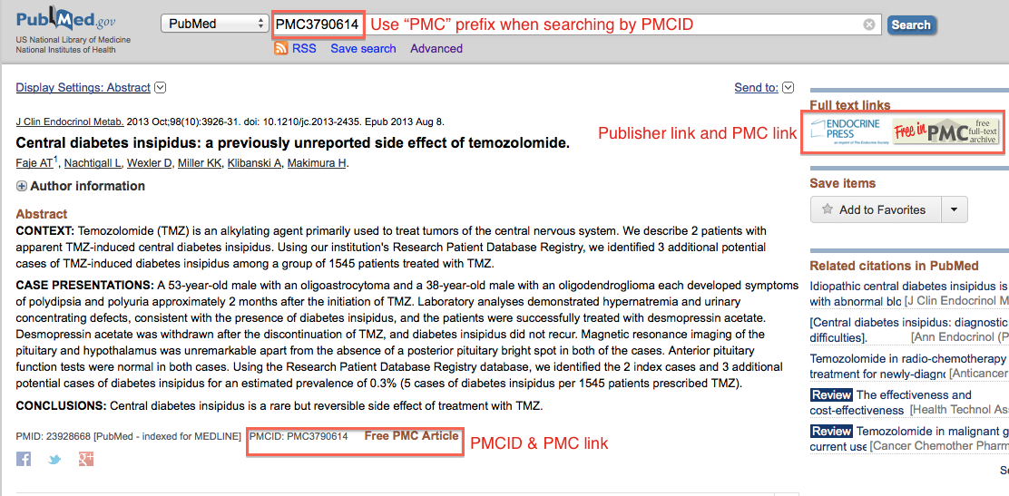
Look up articles with PMCIDs in PubMed
Notes:
Entering PMCID in the PubMed search window will look up the abstract.
This article has been posted to PubMed Central.
From the PubMed Abstract view, the user can see on the upper right side of the page, links to the Journal webpage and the full text of the article in PMC.
The PMCID is located to the right of the PMID underneath the Abstract text.

Slide 59
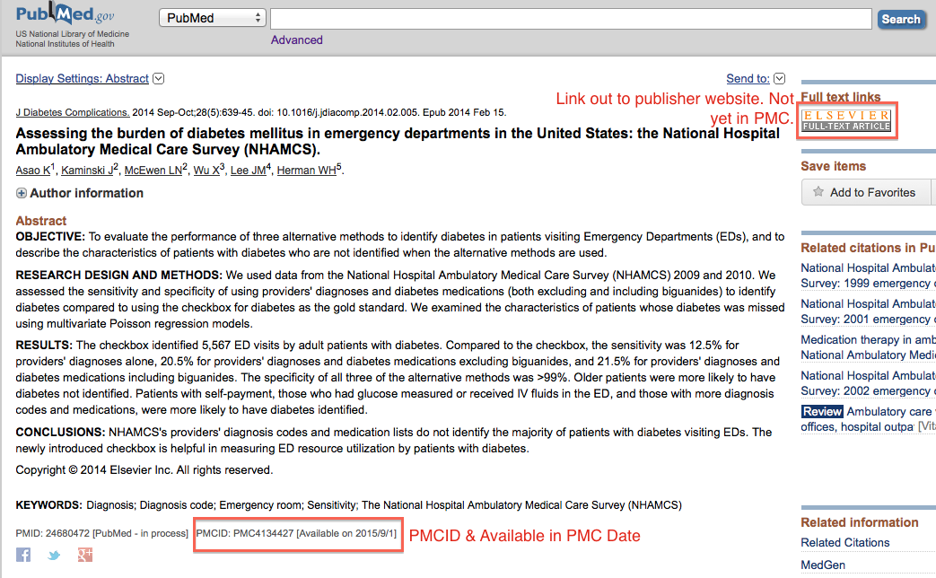
Find PMCIDs in PubMed’s Abstract View
Notes:
This Journal fulfills the submission requirement of the Public Access Policy on behalf of its authors [Method A]. It posts its NIH funded content to PubMed Central to be made publicly available after a delay period.
Note there is a link to the Journal website that the publisher provided in the upper right. There is no link to PMC, as the article is not publicly available on PMC yet.
** The presence of a PMC ID does not necessarily mean journal fulfills the Public Access submission requirement on behalf of their authors

Slide 60
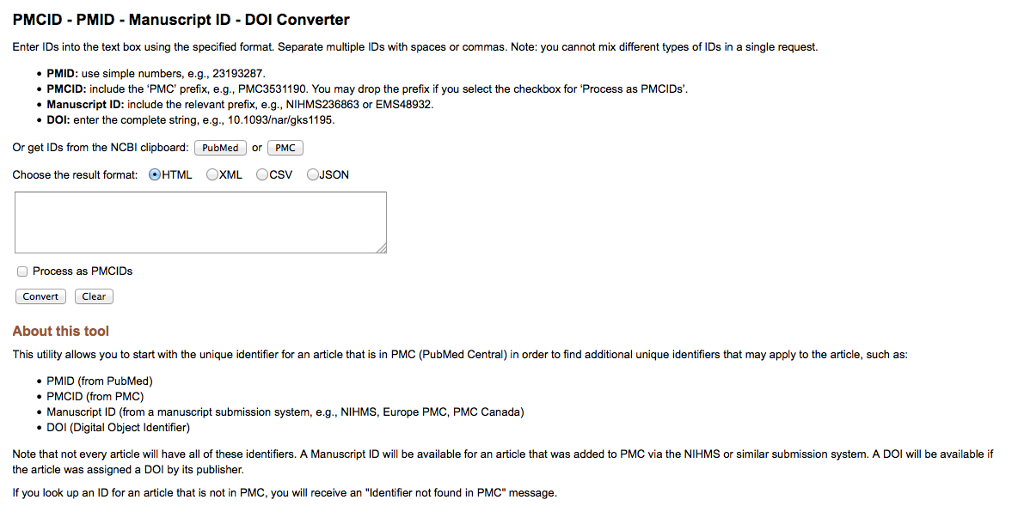
PMCID Converter Tool
http://www.ncbi.nlm.nih.gov/pmc/pmctopmid/
60

Slide 61
NIH Manuscript Submission System: Processing manuscripts

Slide 62
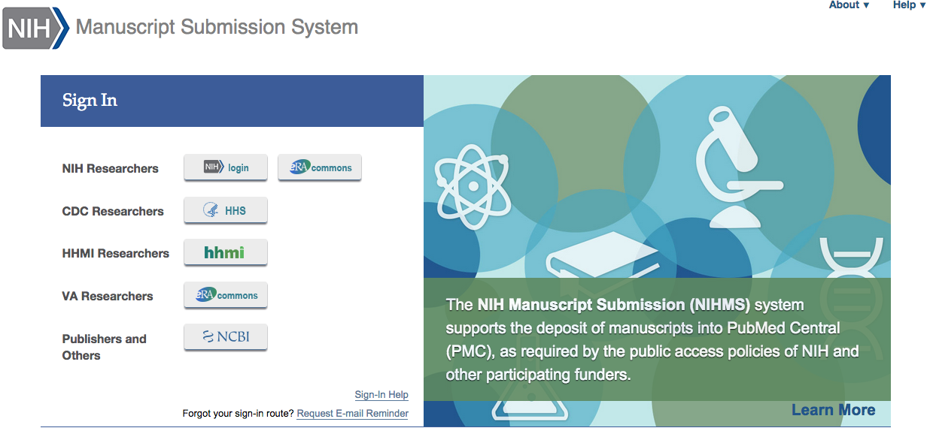
NIHMS Login Options
Each Login route has its own NIHMS account
Submitters must continue to use the same login method for subsequent visits to NIHMS.
Helpful sign in hints
Use the same sign in route each visit.
If you do not remember how you’ve previously signed in, use the “Request E-mail Reminder” link.
NIHMS does not maintain the sign in routes.
Notes:
NIHMS accounts will be kept separate between login routes.
Submitters must continue to use the same login method for subsequent visits to NIHMS.

Slide 63
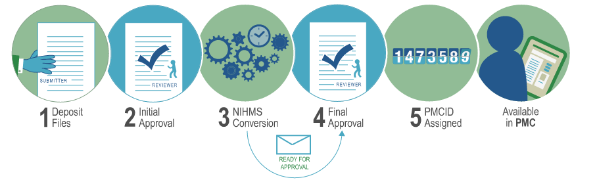
NIHMS Process Overview
https://www.youtube.com/watch?v=IIEBtfnSqMA
Process Notes:
Typically takes about 2-3 weeks from initial approval until first notification of final approval.
Deposit at time of acceptance. Don’t wait until publication or embargo period is up.
PMCID is assigned when final approval is complete and final publication information is available.
* Approval steps must be completed by the assigned Reviewer in NIHMS.
Notes:
Chose reviewer section of NIHMS Review and Approve Submission

Slide 64
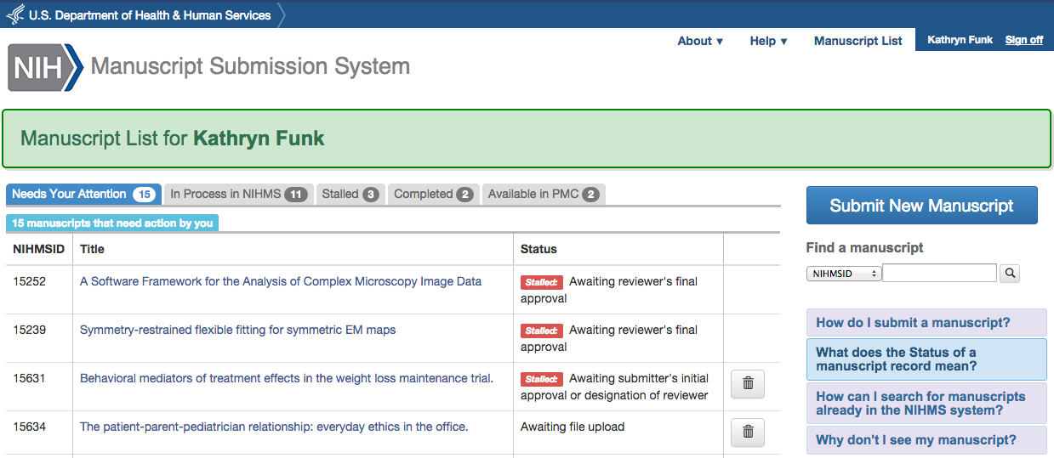
Managing NIHMS Submissions
Navigating the Manuscript List:
Check the “Needs Your Attention” tab.
Check the “Stalled” tab.
Search for submissions.
Submit a new manuscript.
Check the “Available in PMC” tab to view the PMC access statistics for your manuscripts.

Slide 65
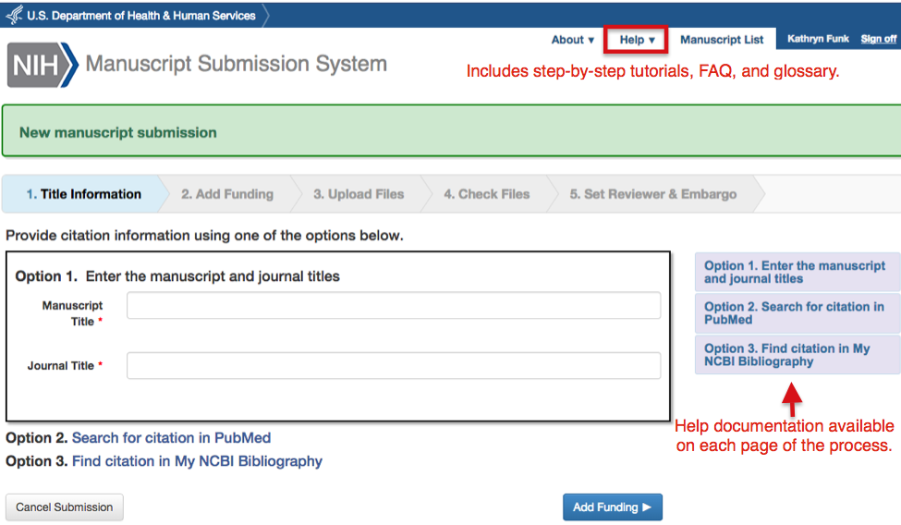
Deposit Files

Slide 66
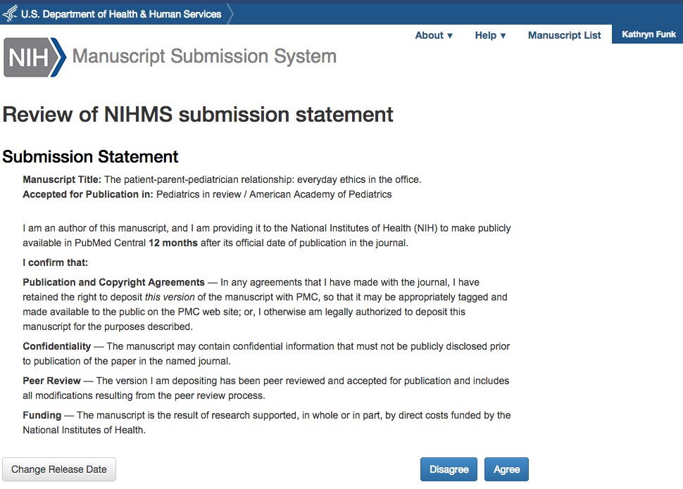
Author Initial Review
Completing the initial review:
Check to make sure that deposited files are complete.
Add relevant funding.
If this is a publisher submission, the embargo will have been set for you.
Review submission statement [pictured here] and “Agree”.

Slide 67
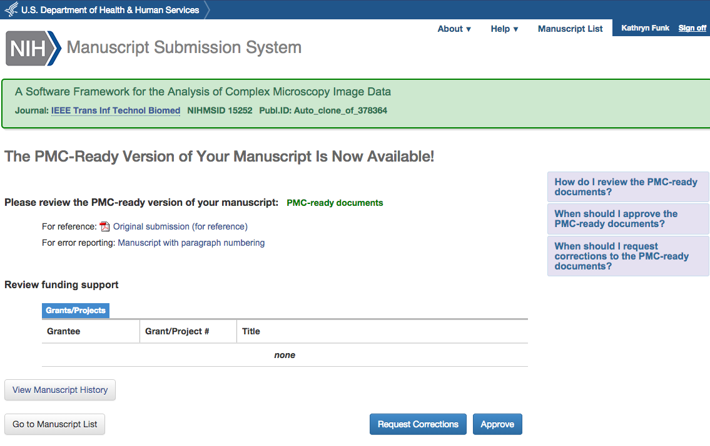
Author Final Review
Completing the final review:
Select “PMC-ready documents” to confirm everything looks okay.
Review funding support.
Either “Approve” or “Request Corrections”
Help information available on the page. See also Help in Navigation.

Slide 68
Public Access Compliance Monitor

Slide 69
What is the Compliance Monitor?
Database of articles, including current compliance status, that are associated with an institution’s (i.e., IPF’s) grants and fall under the NIH Public Access Policy.
GOAL: Give you data to help monitor compliance on an institutional level.

Slide 70
Compliance Monitor Data
PACM
MEDLINE Indexing
My Bibliography
NIHMS
All records are PMID based, ie, Paper has to be in PubMed
Updated twice a week (Wednesdays and Saturdays)
Grant-paper associations come from multiple databases [see graphic]
Notes:
Questions about updates:
Twice a week
Looking to incorporated “last updated” date in PACM
Past: delays in building links between NIHMSID and PMID, resolved
Q: The PACM data is frequently out of date when I am called on to assist researchers. Are there plans to improve the monitor so results are available in real-time?

Slide 71
Benefits of using the Compliance Monitor
Quick summary of institution’s compliance rate
Download reports on non-compliant publications for the entire institution or a single grant
Locate associated IDs for a citation
Track progress of papers in NIHMS
View status changes made in My NCBI, e.g., if a citation is marked as not applicable
For more information, see https://publicaccess.nih.gov/sponsored-programs.htm

Slide 72
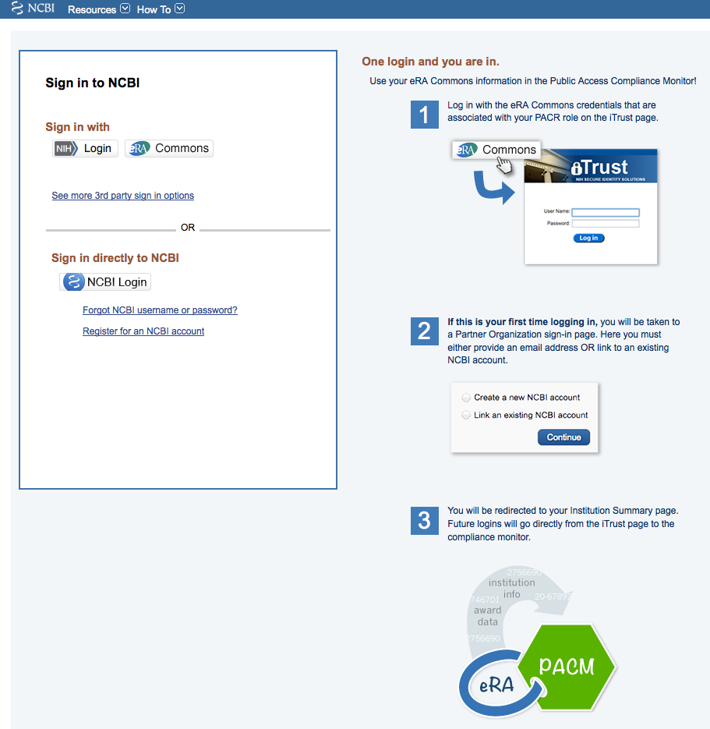
Compliance Monitor Access
PACR Role: Assigned by administrator authorized to assign roles in eRA Commons
Tip #1: Once you are assigned a PACR role, wait 24 hours to log in.
Tip #2: If your institution has multiple IPFs, you will need a PACR role for each.
Tip #3: eRA Commons manages login information, so that is who can troubleshoot login problems (see next slide)

Slide 73
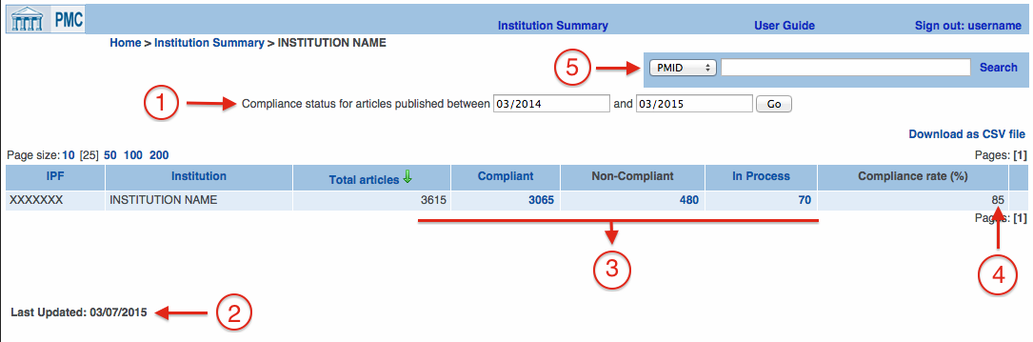
Compliance Monitor: Snapshot of Compliance
Set the date range.
See when data was last updated. (New!)
Overview of current compliance status.
Current compliance rate (for selected date range)
Search for a specific paper by PMID or use the dropdown menu and view article list for a given grant number. (New!)

Slide 74

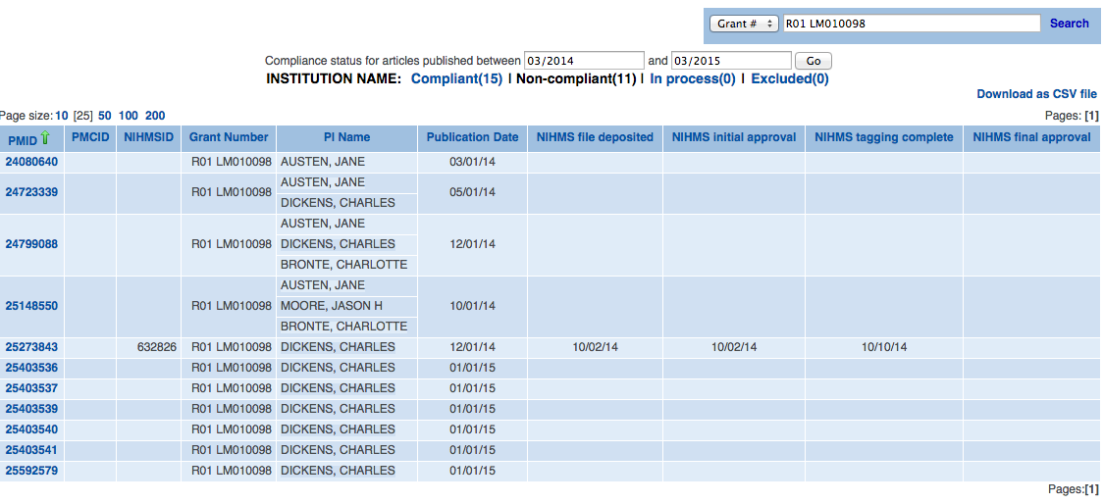
Compliance Monitor: Grant Filter and Article Lists
Grant Filter/Search
Use the same grant format as displayed in the “Grant Number” column.
Default results display is the Non-compliant article list.
Article Lists include
Associated IDs
Associated grant(s) and PI
Publication date (if available)
Key NIHMS dates
Article Lists can be downloaded (next slide)
Notes:
Q: For multi-institutional publications, what dictates which institutional PACM profile(s) the manuscript is listed with? What are the reasons that a manuscript would not be included in an institution's PACM profile?

Slide 75
Compliance Monitor: Downloadable CSV Reports
Identifiers
Grants
Article
Info
NIHMS Info
Article Info
NIHMS Info
Also check out “Understanding a Public Access Compliance Monitor (PACM) Report” by Bernard Becker Medical Library at Washington University:
https://becker.wustl.edu/sites/default/files/PACM_Legend.pdf
Notes:
Value of reports: Can be filtered! Distributed!
Identifiers
Grants (all PI’s)
Article Info – publication date useful for determining grace period,
NIHMS Info

Slide 76
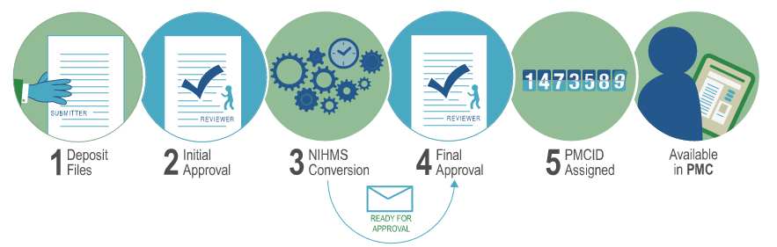
NIHMS Info in the Compliance Monitor
NIHMS Process Overview
Files Deposited
Initial Approval
Tagging Completed
Final Approval
NIHMS dates in PACM
Notes:
Q: Please provide overview of NIH’s process for re-formatting author manuscripts.
Q: What happens if an author uploads the typset or final published version, without the publisher’s approval?
?? Q: What happens if an author uploads the typeset or final published version, without the publisher’s approval? Does NIH process regardless?
Q: Is it possible for the delay period between two approval steps to be shortened?

Slide 77
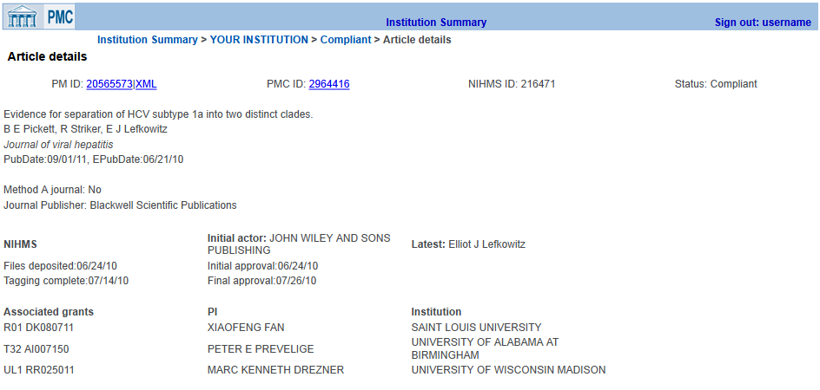
Compliance Monitor: Article Details
Notes:
Same information as the report
Opportunity to address submission methods A and D
Q:

