Slide 1
Understanding the New NIH Data Management & Sharing Policy
A CONVERSATION WITH NIH
CONVERSATIONS WITH NIH
Webinar Series – Part 2
Diving Deeper into the New NIH Data Management and Sharing (DMS) Policy
September 22, 2022
Part 1
August 11, 2022
1:30 – 3:00 PM
Hosts:
NIH Office of Extramural Research (OER)
NIH Office of Science Policy (OSP)

Slide 2
Today’s Discussion
Best practices for protecting privacy when using data from human participants
Considerations for working with American Indian and Alaska Native participants
Interaction with Genomic Data Sharing Policy
And more!

Slide 3
NIH has a longstanding commitment to making the results of research available
Data Management and Sharing Policy will create a consistent minimum expectation for all research supported by the agency.

Slide 4
DMS Policy Overview
Applicability
All research, funded or conducted in whole or in part by NIH, that results in the generation of "scientific data".
Requirements
Submission of DMS Plan with all applications for funding
Compliance with the DMS Plan approved by the funding NIH Institute, Center, or Office
See Research Covered Under the Data Management & Sharing Policy

Slide 5
Planning & Budgeting
DMS Plans
DMS Costs
Describe how data will be managed and shared
Address 6 key elements
Optional format page
Request funding to support data management and sharing activities
See Writing a Data Management & Sharing Plan
See Budgeting for Data Management & Sharing

Slide 6
Timelines & Repository Selection
Timeline for Sharing
Selecting Repositories
Soonest of following timepoints:
Publication of findings in a peer-reviewed journal, OR
End of the award
Use of established repositories is encouraged
Many resources and repository lists to help
See Sharing Scientific Data

Slide 7
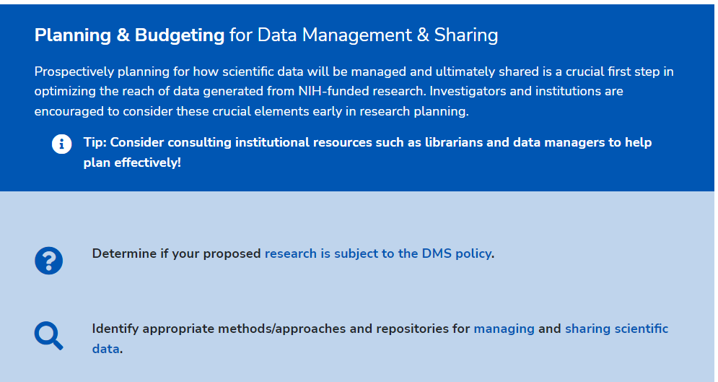
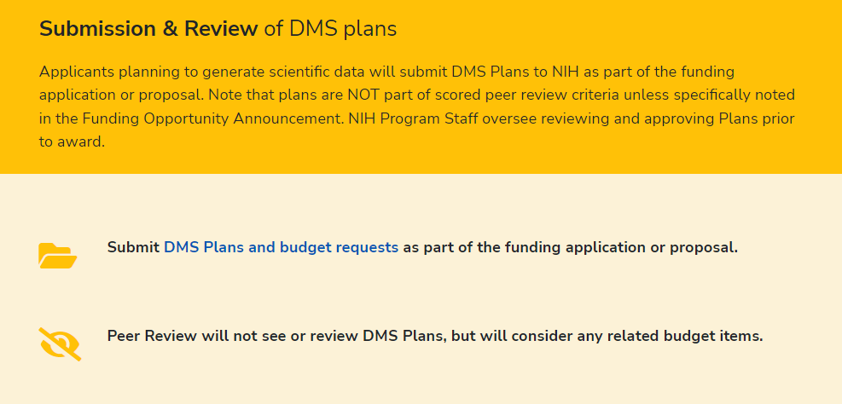
DMS Policy Overview Webpage
Data Management and Sharing Policy Overview

Slide 8
Webinar 1 Resources
Webinar Recording
Resource Slide Deck

Slide 9
Recent Resources
Supplemental Information: Protecting Privacy When Sharing Human Research Participant Data (NOT-OD-22-213)
Supplemental Information: Responsible Management and Sharing of American Indian/ Alaska Native Participant Data (NOT-OD-22-214)
Implementation Changes for Genomic Data Sharing Plans Included with Applications Due on or after January 25, 2023 (NOT-OD-22-198)
See Statements & Notices

Slide 10
White House OSTP Memo
Directs all Federal agencies to develop plans to ensure:
Publications resulting from federally funded research are made freely available and publicly accessible without embargo
Scientific data underlying publications should be made accessible at time of publication
Approaches for sharing scientific data not underlying publications
Initial agency plans due February 2023
No change anticipated for the NIH DMS Policy
White House Memo

Slide 11
Supplemental information for Protecting Privacy When Sharing Human Research Participant Data
Provides a basic framework for considering how to protect privacy when sharing data from human participants
Not intended as a guide for regulatory compliance
Broadly applicable to different research contexts
Establishes shared principles, provides best practices, and offers considerations for determining whether to control access to data
NOT-OD-22-213

Slide 12
Best Practices for Protecting Privacy When Sharing Human Research Participant Data
De-identify to the greatest extent while maintaining scientific utility; Use Common Rule and HIPAA Privacy Rule standards
Use agreements for transferring data
Communicate limitations on use, include prohibitions on re-identification or recontact
Consider risks from information even when de-identified
Share identifiable data only with explicit consent
Understand applicable legal protections and limitations on disclosure
1.
2.
3.

Slide 13
Sharing Scientific Data Protected by a Certificate of Confidentiality (CoC)
Scientific data protected by CoCs can be shared in a manner consistent with those protections.
CoC protections are not a barrier to the responsible sharing of data envisioned in the DMS Policy

Slide 14
Certificates of Confidentiality (CoC)
Ethical and legal obligation to protect participants' privacy and the confidentiality of their data.
CoCs protect the privacy of research participants by prohibiting compelled disclosures (e.g. subpoenas, court orders) of their identifiable, sensitive research information that is gathered or used during the course of research
Definition of “identifiable information”
Information through which an individual is identified; or
Information for which there is at least a very small risk, that some combination of the information, a request for the information, and other available data sources could be used to deduce the identify of an individual
Limited circumstances under which disclosure of protected information is required
Certificates of Confidentiality

Slide 15
Factors to Consider: Type of Access
Sharing through controlled access if…
Explicit limitations on sharing
Data pose particular risks to participants or groups
Data cannot be sufficiently de-identified
Unanticipated risks are discovered after initial planning
Sharing through unrestricted access if….
Explicitly consented for unrestricted sharing
De-identified and institutional review finds unrestricted sharing poses very low risk

Slide 16
Responsible Management and Sharing of American Indian/ Alaska Native Participant Data
Information to assist in developing appropriate DMS Plans
Emphasizes:
Respect for Tribal Sovereignty
Partnerships and mutual agreements
Building trust
Developed through Tribal Consultation and stakeholder engagement beginning in 2019
NOT-OD-22-214

Slide 17
Best Practices for Responsible Management and Sharing of AI/AN Participant Data
Understand
Understand Tribal sovereignty and laws, regulations, policies, and preferences
Engage
Engage early with Tribes when developing a data management and sharing plan, before research begins, and continue throughout research
Establish
Establish mutually beneficial partnerships
Agree
Agree who will manage data (e.g., Tribe, researcher, trusted 3rd party)
Consider
Consider additional protections, as necessary

Slide 18
GDS Policy Overview: Scope & Applicability
Purpose
Sets expectations and responsibilities to ensure broad, responsible, and timely sharing of genomic research data
Scope
All NIH-funded research generating large-scale human or non-human genomic data and secondary research using these data
Applies to all funding mechanisms regardless of cost
Data Sharing Plans
Effective January 25, 2023, separate GDS Plan WILL NOT be accepted (NOT-OD-22-198)
Submit a DMS Plan, anticipating sharing according to the Institutional Certification
Genomic Data Sharing Policy

Slide 19
GDS Policy Overview: Data Submission & Access
Data Submission
DMS Plan required
For human data – institutional certification must be submitted at just-in-time
Data should be submitted to an NIH designated repository
Access and Secondary Use
To use data in controlled access repositories, researchers and their institutions must:
submit and receive approval for a data access request
abide by the associated requirements for responsible data use

Slide 20
Research Subject to DMS and GDS Policies: Areas of Harmonization
DMS Plan: submit a single Plan that addresses GDS and DMS policies
DMS Plans Review: conducted by program staff, not by peer reviewers
Budget Considerations: detailed budget should include allow allowable costs for all data types
Compliance: for awards will be handled in accordance with DMS policy compliance and enforcement terms
Timing of Data Sharing: GDS policy guidance provides specific timelines, the latest possible time to submit data will be at the end of the award performance period
NOT-OD-22-198

Slide 21
GDS Policy Overview: Data Sharing Plan Considerations
Instructions for all scientific data
Additional expectations for genomic data
Writing a Data Management & Sharing Plan

Slide 22
Informed Consent and DMS Policy
No additional expectations for informed consent
Use of broad consent is not required
Recognition of limitation on data sharing based on the content of the informed consent process
Informed Consent Resources:
Points to consider
Sample language for future use and/or data sharing
Informed Consent Resource

Slide 23
DMS Plan Assessment
Program staff ensure the Elements of a DMS Plan have been adequately addressed and assess the reasonableness of those responses
Applications will only be funded when DMS Plan is complete and acceptable
Program staff will determine whether the DMS Plan appropriately considers factors that may limit sharing
See Writing a Data Management & Sharing Plan and this FAQ

Slide 24
When should I share my data?
As soon as possible!
No later than the time of a publication of findings in a peer-reviewed journal OR at the end of the award, whichever comes first
Sharing
Collection
Analysis/ Curation
Storage
Access/ Archive
Notes:
SLIDE L

Slide 25
Secondary Research and Primary Data
Research that obtains or analyzes primary data can generate scientific data and be subject to the DMS Policy
Primary data already shared should not be shared again
Policy focuses on scientific data generated during research, but primary data not already shared may be valuable to share
See FAQ

Slide 26
Activities Subject to the DMS Policy
APPLIES TO…
All research generating scientific data, including but not limited to:
Research Projects
Certain Career Development Awards (Ks)
Small Business SBIR/STTR
Research Centers
DOES NOT APPLY TO…
research projects not generating scientific data or non-research projects, including but not limited to:
Training (Ts)
Fellowships (Fs)
Construction (C06)
Conference Grants (R13)
Resources (Gs)
Research-Related Infrastructure Programs (e.g., S06)
See Research Covered Under the Data Management & Sharing Policy

Slide 27
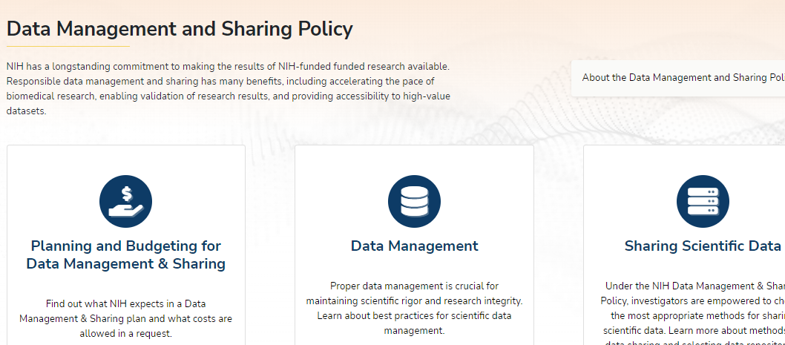
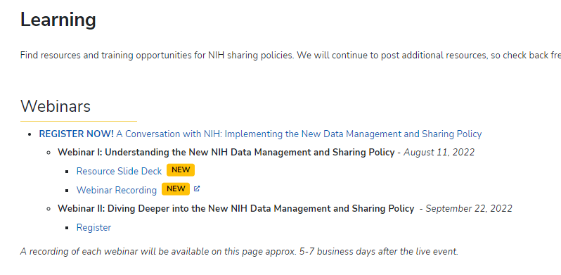
For More Information…
Website: NIH Scientific Data Sharing
FAQs: DMS Policy FAQs
Email Box: Sharing@nih.gov

Slide 28
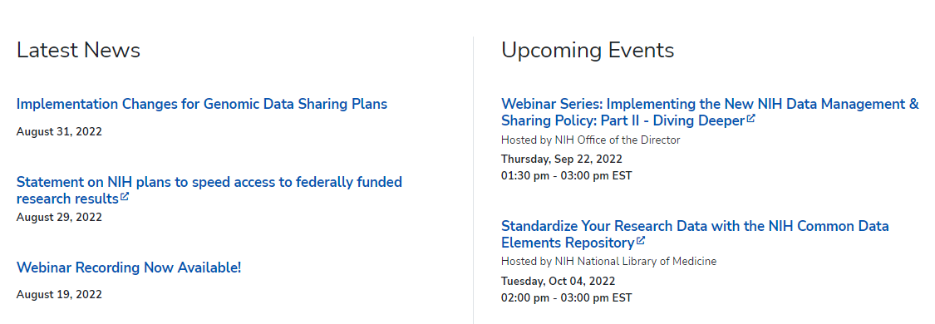
Stay in the loop!
BLOGS
LISTSERVS
Extramural Nexus
NIH Guide to Grants & Contracts
Office of Science Policy News
NIH Scientific Data Sharing News & Events
Under the Poliscope
Open Mike
SOCIAL MEDIA
@NIHGrants
@NIH_OSP
News & Events

