Slide 1
Security Update for Approved Users: Securing NIH Controlled-Access Genomic Data
Cheryl Jacobs, PhD
Assistant Director for Genomics and Data Access Office of Science Policy
Maureen Falvella, CISSP, PMP
NIH Chief Information Security Officer (Acting) Office of the Chief Information Officer
Community Days January 8, 2025

Slide 2
NIH Presenters
Dr. Cheryl Jacobs
Assistant Director for Genomics and Data Access Office of Science Policy
Maureen Falvella
NIH Chief Information Security Officer (Acting)

Slide 3
Agenda
Overview of Guide Notice NOT-OD-24-157 – 15 Minutes
Dr. Jacobs will provide an overview of implementation updates for NIH controlled-access data repositories, Developers, and Approved Users
Overview of NIST SP 800-171 Series – 20 Minutes
Ms. Falvella will provide an overview of the NIST Special Publication 800-171 series and how institutions can leverage the series to comply with "NIH Security Best Practices for Users of Controlled-Access Data" in NOT-OD-24-157
Questions & Answers – 25 Minutes
Ms. Falvella and Dr. Jacobs will answer questions on NOT-OD-24-157

Slide 4
Effective January 25, 2015 ​ NIH Genomic Data Sharing (GDS) policy
Purpose
Sets expectations and responsibilities to ensure broad, responsible, and timely sharing of genomic data
Informed consent for research use and sharing (human)
Scope
Applies to all NIH-funded research generating large-scale human or non-human genomic data and secondary research using these data
Applies to all funding mechanisms (grants, contracts, intramural support) regardless of cost

Slide 5
GDS Policy Framework For Participant Protections
NIH-funded investigators who generate large-scale human genomic data are expected to submit the data to NIH and assure that:
Data are appropriate to submit to NIH and share
Data are shared according to participant consent
An IRB has reviewed the risks to individuals and groups
Approved Users of these data, whether NIH-funded or not, agree to:
terms of access described in the Data Use Certification Agreement,
the Genomic Data User Code of Conduct, and
the NIH Security Best Practices for Controlled-Access Data Subject to the GDS Policy

Slide 6
NOT-OD-24-157 Effective January 25, 2025​ Update to GDS data management & access practices
NIH issued a single update to data management and access practices under the GDS Policy that addresses both the security practices and developer access, and applies to:
NIH controlled-access human genomic data repositories and access systems that meet the following criteria:
Are supported by a NIH grant, cooperative agreement, Other Transaction, contract, or intramural support,
Store or provide access to human genomic data generated and shared under the GDS Policy,
Control access to human genomic data by prospective review of data access requests, and
Use Federal employees to conduct reviews and authorize access
Developers who test platforms, pipelines, analysis tools, and user interfaces that store, manage, and interact with human genomic data from NIH controlled-access repositories as well as provide infrastructure development and repository maintenance
Approved Users of controlled-access human genomic data from NIH controlled-access repositories

Slide 7
NIH controlled-access human genomic data repositories
20 NIH controlled-access data repositories are within scope of the update
NIH has notified these repositories
The current list of repositories are on the NIH Scientific Data Sharing website (https://sharing.nih.gov/accessing-data/NIH-security-best-practices)
If your repository is not currently listed, this update is not applicable.
Institutions that generate large-scale human genomic data as a part of an award, and store it at their institution, cloud-service provider, or third-party IT system are not in scope

Slide 8
Minimum Standard Operating Procedures for Developer ACCESS
This is a pathway specific to NIH- or federally-funded developers
Lead Developers submit a Developer Use Statement to the NIH Developer DAC for review
Central to this definition is that the work must relate to developing or maintaining NIH controlled-access data repositories (see a current list of those repositories here: https://sharing.nih.gov/accessing-data/NIH-security-best-practices)
As of January 25, 2025, NOFOs, contracts, or Other Transactions, going forward, will indicate the applicability of the update and developer terms of access (see here for terms of access: https://grants.nih.gov/grants/guide/notice-files/NOT-OD-25-021.html)

Slide 9
Approved Users of controlled-access human genomic data from NIH controlled-access Data repositories
This applies to Principal Investigators (PIs) who are approved to access data from NIH controlled-access data repositories
Once approved, are Approved Users
Approved Users agree to terms of access in the Data Use Certification or Data Use Agreement (e.g., “NIH Security Best Practices for Controlled-Access Data Subject to the NIH Genomic Data Sharing (GDS) Policy”)
On January 25, 2025, Approved Users who submit a new request or renew an existing request will be expected to secure data according to the updated NIH Security Best Practices
To that end, NIH expects that:
Approved Users will attest to NIH that the system storing human genomic data is compliant with NIST SP 800-171.
Approved Users choosing a third-party IT system and/or Cloud Service Provider for data analysis and/or storage will provide NIH with an attestation affirming that the third-party system is compliant with NIST SP 800-171.
Non-U.S. users that are unable to attest to the NIST SP 800-171 may attest to the equivalent ISO/IEC 27001/27002 standard.
The attestation may vary. The PI’s and institution’s ability to attest is informed by a self-assessment.

Slide 10
Global Threats: Protecting NIH Controlled-Access Data
Nation State Actors
Criminal Organizations
Adversarial Technology
Highly sophisticated foreign state funded actors who disrupt or compromise systems to gain intelligence, demonstrate capabilities, gain access to valuable information, disrupt or compromise IT systems.
Criminal organizations compromising IT systems or disrupting operations for financial gain.
Adversaries leveraging modern technologies such as AI tooling, super computing, and Ransomware-as-a-Service (RaaS) to deliver attack campaigns.
Protecting Public Trust in a Digital Age
Erosion of public trust and financial losses from cybersecurity attacks present substantial challenges to research institutions.
The public Healthcare secure experienced an 84% increase in the number of data breaches from 2018-2021.
In 2022, healthcare and research institutions experienced a 125% increase in ransomware attacks, compared to the preceding year.
With post-quantum computing power and AI capabilities, linking identities from de-identified information is an increasing concern.
NIH is ensuring protection of public trust and preparing for future national security directives and security policies.
NIH is unifying the standards to ease burden on institutions seeking funding opportunities at NIH.

Slide 11
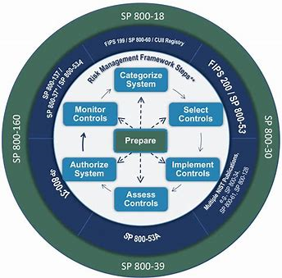
As a Researcher – Here’s What You Need to Know NIH Security Best Practices for Users of Controlled-Access Data
NIH Security Best Practices are security benchmarks to measure security posture against NIST SP 800-171 security controls and the NIST Risk Management Framework. (It is NOT rigid regulator requirements).
Framework offers a pathway to achieve attainable security best practices through a 6-phase process which continuously monitors risk throughout system lifecycle (inception to decommission).
The NIH Security Best Practices for Users of Controlled-Access Data are only expected for those systems that handle the controlled-access data.
Systems at the institution that do not interact with the controlled-access data are not expected to adopt the security standards.
By January 25, 2025, Institutions are expected to assess their systems against the NIST SP 800-171 controls and, to the best of their ability, implement the security controls.
Any deviations, must be documented with a Plan of Action and Milestones to further mitigate the risk.
Once assessments have been made and deviations documented, institutions should inform their researchers so they can attest to the NIH Security Best Practices when submitting new or renewal data access requests to NIH controlled-access genomic data.
On or after January 25th, 2025, approved users of NIH controlled-access genomic data are expected to attest to protecting data in accordance with NIST SP 800-171 (or equivalent international standard.
Users choosing a third-party IT system and/or Cloud Service Provider (CSP) for data analysis and/or storage for their project should provide the NIH controlled-access repository or access system with an attestation that the third-party system is compliant with NIST SP 800-171. 1

Slide 12
As Institution IT Support Staff – Here’s What You Need to Know NIST SP 800-171 Series
Security Requirements for NIST Special Publication 800-171 and the 17 Security Controls Families
Access Control
Awareness & Training
Audit & Accountability
Configuration Management
Identification & Authentication
Incident Response
Maintenance
Media Protection
Personnel Security
Physical Protection
Risk Assessment
Security Assessment & Monitoring
System & Communications Protection
System & Information Integrity
Planning
System & Services Acquisition
Supply Chain Risk Management
NIH will accept Rev. 2 or Rev. 3 as fulfilling the security expectations in the NIH Security Best Practices for Users.
Notes:
NIST Special Publication 800-171 is derived from the same standard applied to Federal information systems regulated under FISMA.
However, the 800-171 series is focused on non-federal information systems and ONLY includes the controls relevant to protecting the confidentiality of the system’s information.
The 800-171 series is made up of 17 control families.
Rev 3 includes two additional families and one modified standard – mainly focused on supply-chain risk management and acquisitions.
Rev 3 consolidated the controls within the 17 families. Rev 3 only has 97 controls – which reduces the total number of controls by 13 controls.
NIH will accept Rev. 2 or Rev. 3 as fulfilling the security expectations in the NIH Security Best Practices for Users

Slide 13
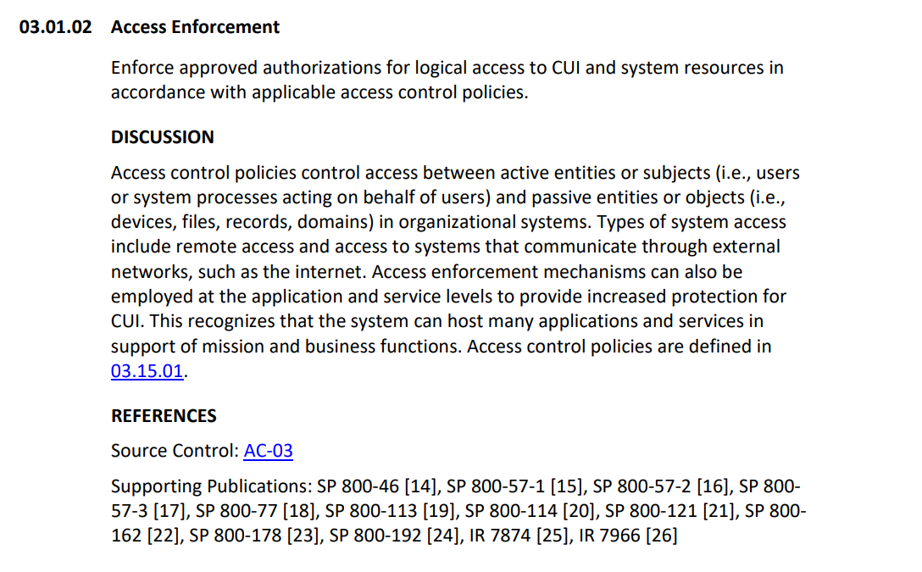
Anatomy of NIST SP 800-171 Controls Implementing Controls
Requirement
ID & Name
Some Controls will List Organizational Requirements
Requirement Text
Requirement Description
Additional Guidance
Cross-walk to NIST 800-53 Controls
Notes:
(Overview of 1800 171 Refer to video) Listed on this slide is a comparison of NIST SP 800-171 Rev 2, Rev 3, and anatomy of these controls.
Rev 2: The controls are more complex and difficult for organizations to implement within their systems. The RMF control families are less customizable for review and integration.
Rev 3: Planning baselines, supply chain risks, and security safeguards are scalable with current controls.
NIST SP 800-171A: Assessment methods are easier to use with non-federal systems.

Slide 14
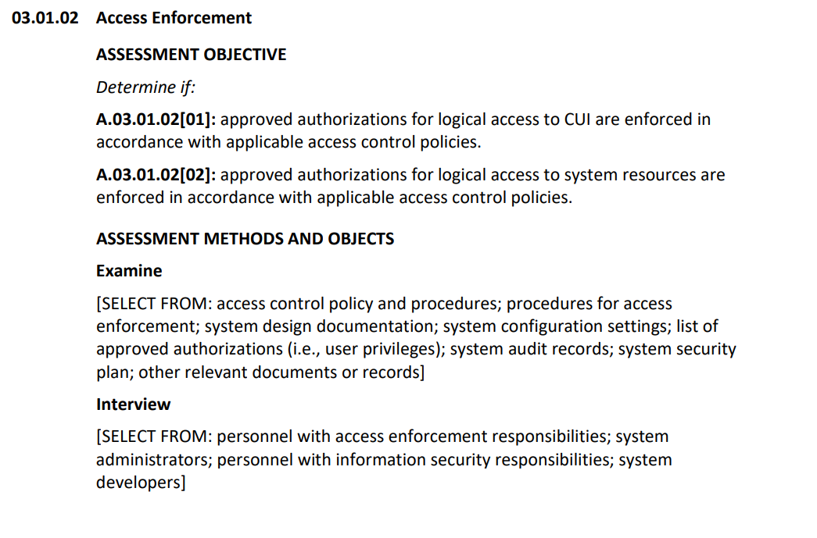
Anatomy of NIST SP 800-171A Assessing Controls
Requirement
ID Name
Artifacts are Appropriate to Examine
Requirements To Be Assessed
Which Personnel are Appropriate to Interview
Three Methods Available for Assessment
Which Technical Controls are Appropriate to Test
Notes:
Assessment - This is a methodology used to Determine if the controls selected for implementation are implemented correctly, operating as intended, and producing the desired outcome.
Highlights the key role of compliance with NIST SP 800-171 security control requirements.
Stresses Continuous Monitoring (ConMon) to quickly adapt to evolving cyber threats and regulatory requirements.

Slide 15
NIST Cybersecurity and Privacy Reference Tool (CPRT)
NIST seeks to accelerate the adoption of its cybersecurity and privacy standards, guidelines, and frameworks by making it much easier for users of NIST products to identify, locate, compare, and customize content across NIST’s standards, guidelines, and practices.
NIST SP 800-171 - Cybersecurity and Privacy Reference Tool | CSRC
NIST SP 800-171a - Cybersecurity and Privacy Reference Tool | CSRC
NIST SP 800-171 Control Overlay
Video Overview of NIST SP 800-171 Rev 3 by Victoria Pilliteri from NIST
Notes:
(Overview of 1800 171 Refer to video) Listed on this slide is a comparison of NIST SP 800-171 Rev 2, Rev 3, and anatomy of these controls.
Rev 2: The controls are more complex and difficult for organizations to implement within their systems. The RMF control families are less customizable for review and integration.
Rev 3: Planning baselines, supply chain risks, and security safeguards are scalable with current controls.
NIST SP 800-171A: Assessment methods are easier to use with non-federal systems.

Slide 16
Key Steps to Complying with NIH Best Security Practices
IT Support Staff - Assess In-Scope systems against the NIST SP 800-171 Controls and, to the best of their ability, implement the security controls.
Scope
Systems that process and or download NIH Controlled-access Genomic data.
IT Support Staff - Develop Plan of Action and Milestones (POA&M) for any controls that are partially implemented or planned to be implemented. ​
Institution - Communicate Compliance Status to Researchers and Staff – so they know they can attest to the appropriate protections. ​
Researchers – On or after January 25, 2025 Attest to Protecting NIH Genomic Controlled-Access Data –when requesting new requests or renewing access to NIH Controlled-Access Data

Slide 17
Support & Resources
Support & Resources
NIH Resources:
Genomic Data Sharing Policy | Data Sharing (nih.gov)
NOT-OD-24-157: Implementation Update for Data Management and
Access Practices Under the Genomic Data Sharing Policy (nih.gov)
NIH-Security-BPs-for-Users-of-Controlled-Access-Data.pdf
NIH-Security-BPs-for-Controlled-Access-Repositories.pdf
Frequently Asked Questions (FAQs) | Data Sharing
Additional Resources:
NIST 800 53: https://csrc.nist.gov/pubs/sp/800/53/r5/upd1/final
SP 800-53 Rev. 5, Security and Privacy Controls for Information Systems and Organizations | CSRC
NIST 800 171 Rev 3: SP 800-171 Rev. 3, Protecting Controlled Unclassified Information in Nonfederal Systems and Organizations | CSRC
NIST 171 Rev 2: SP 800-171 Rev. 2, Protecting Controlled Unclassified Information in Nonfederal Systems and Organizations | CSRC
NIST 171 A: SP 800-171A, Assessing Security Requirements for Controlled Unclassified Information | CSRC

Slide 18
Thank You! Submit Questions in the Chat
Have additional questions?
Questions can be emailed to gds@nih.gov

